Slide 1

Educake Student Guide
www.educake.co.uk

Slide 2
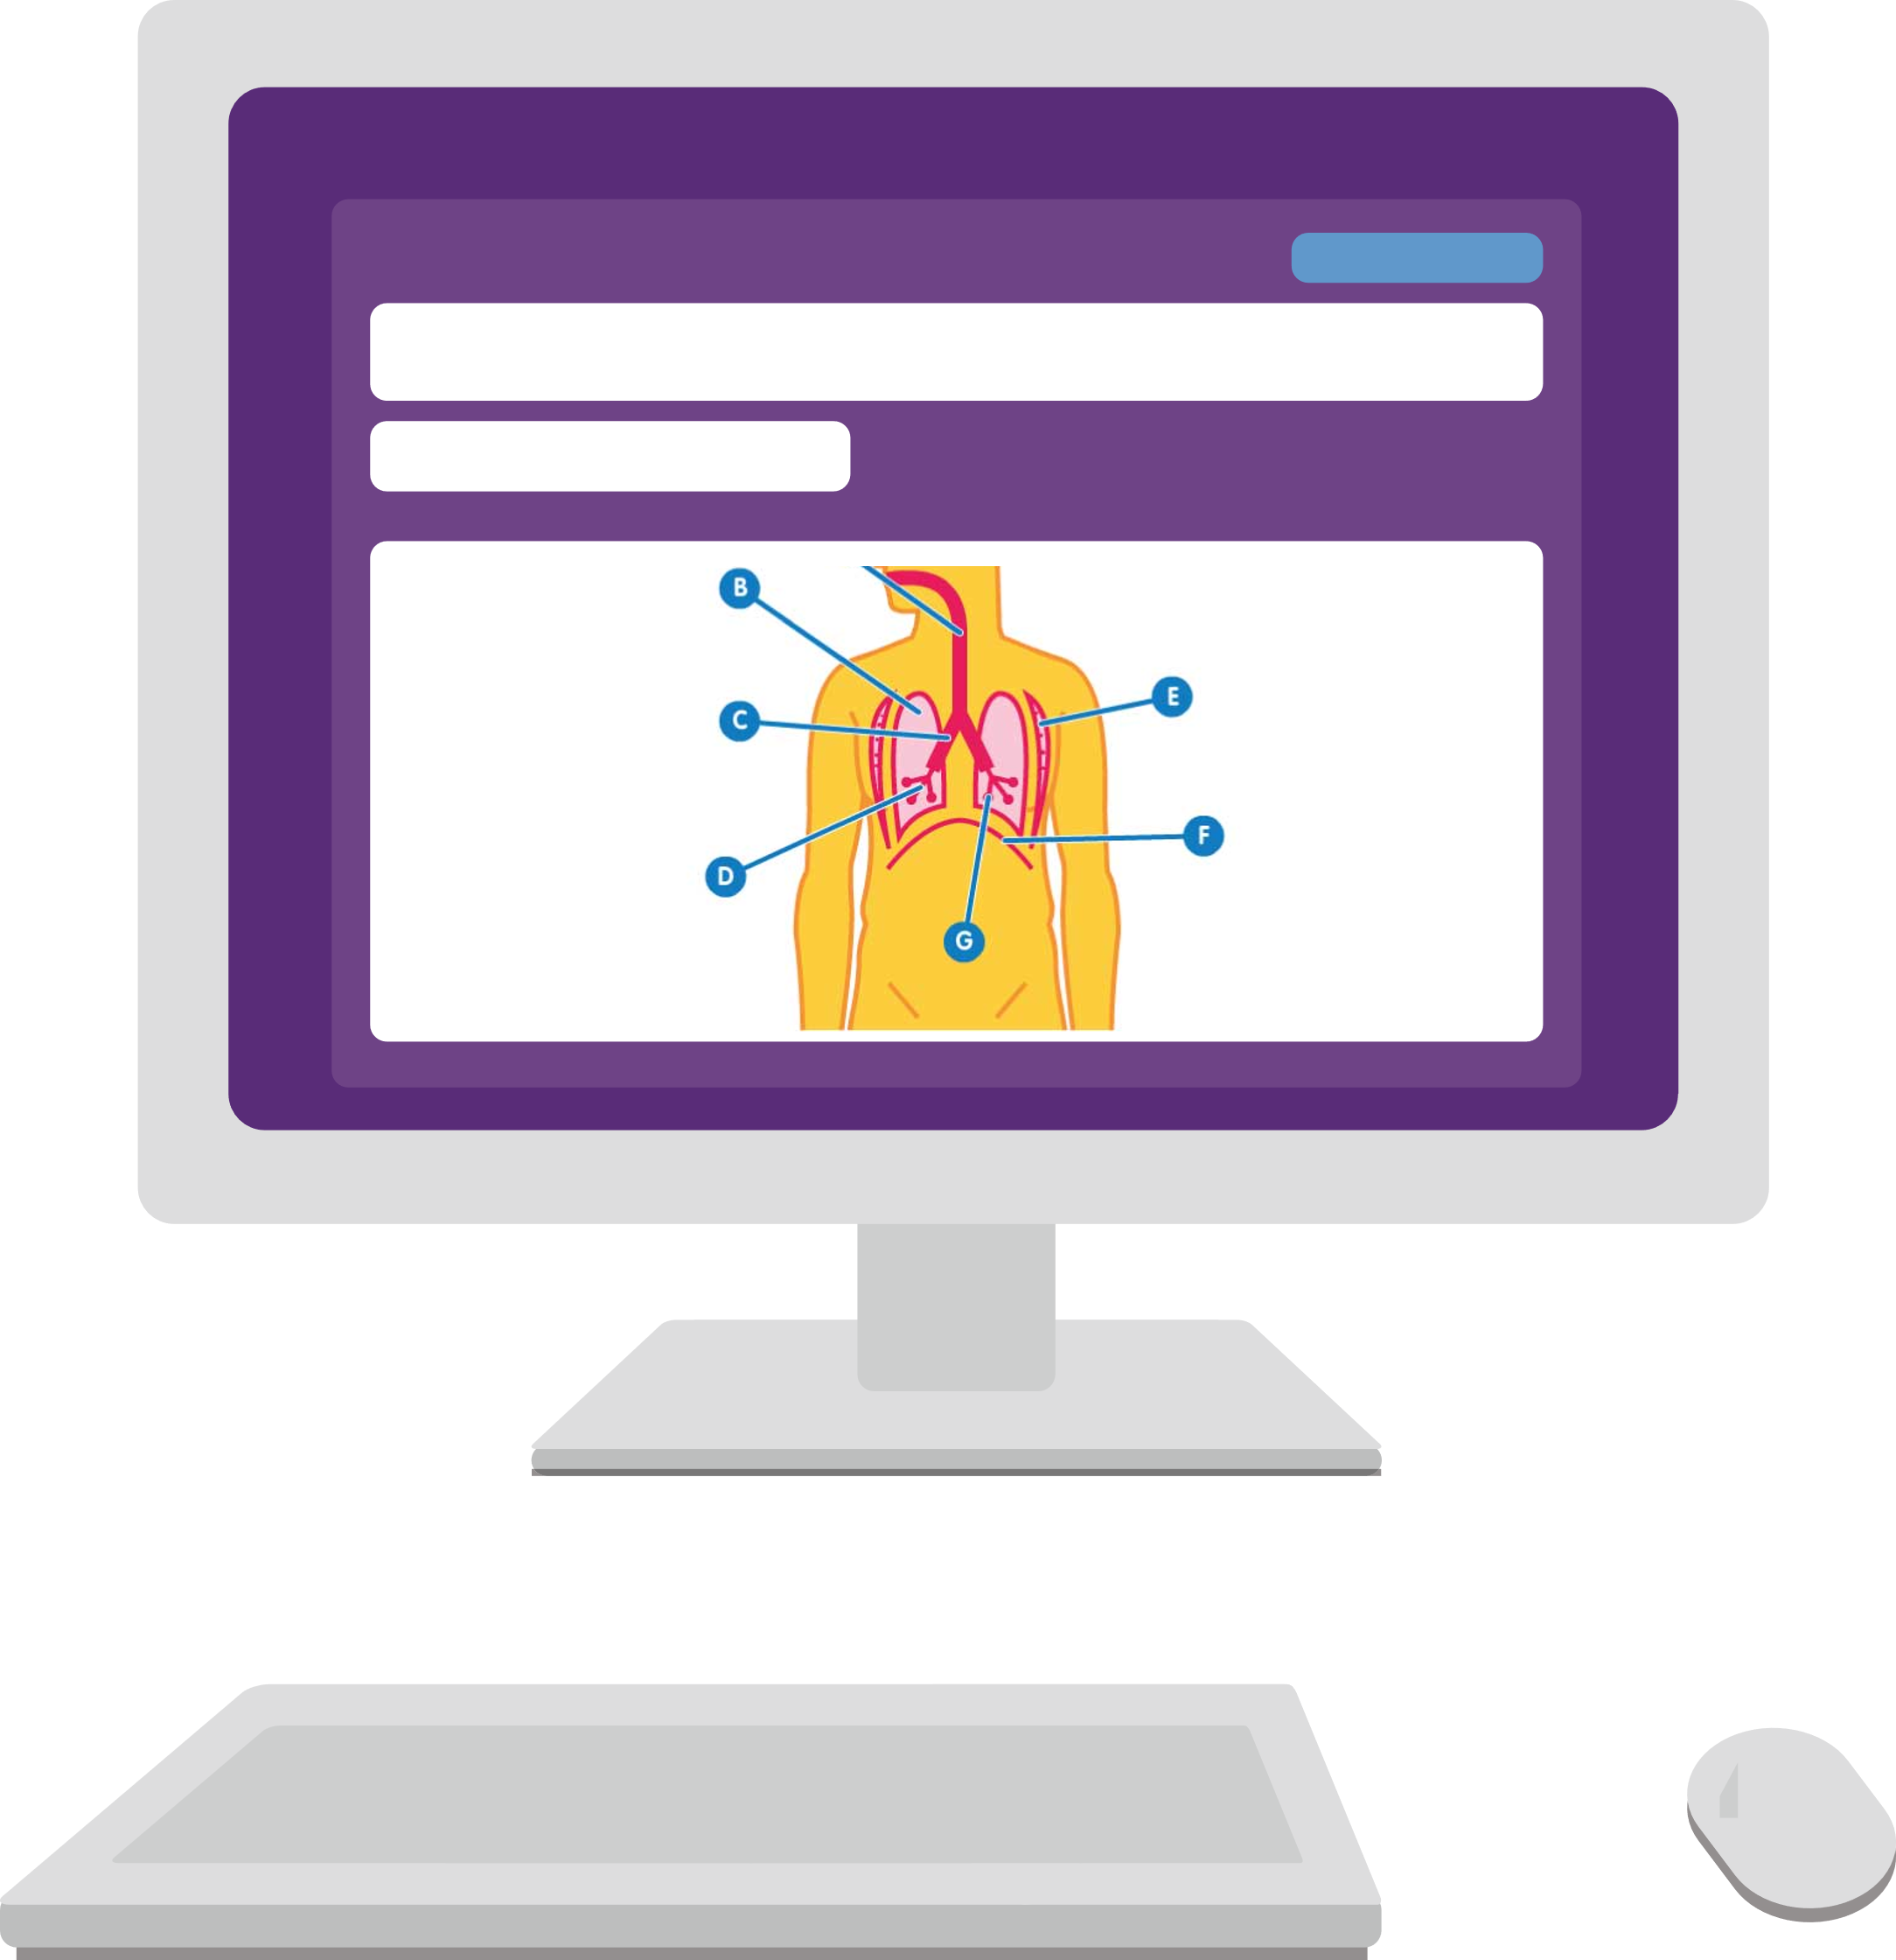
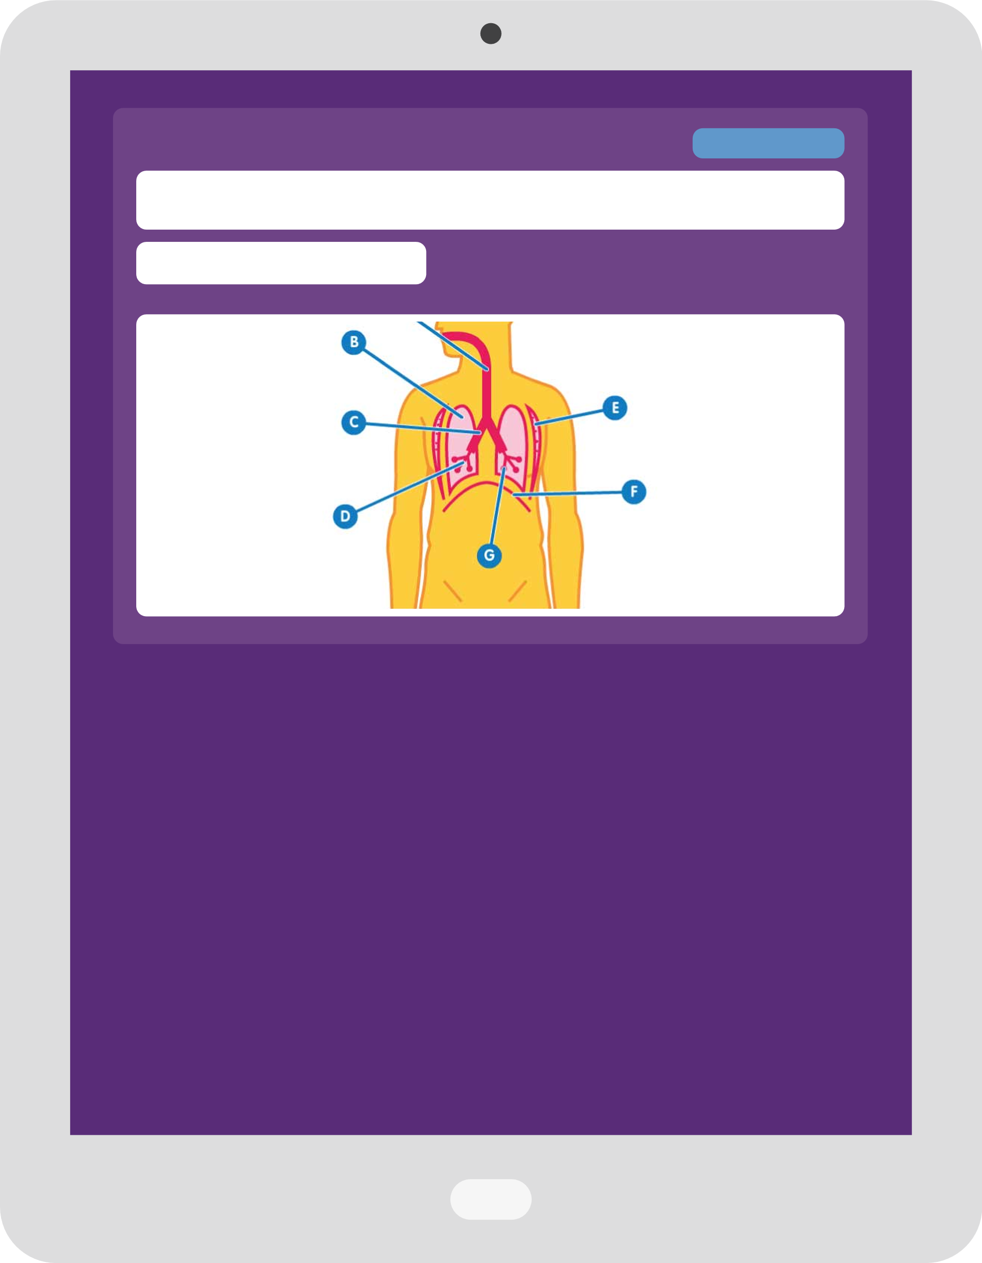
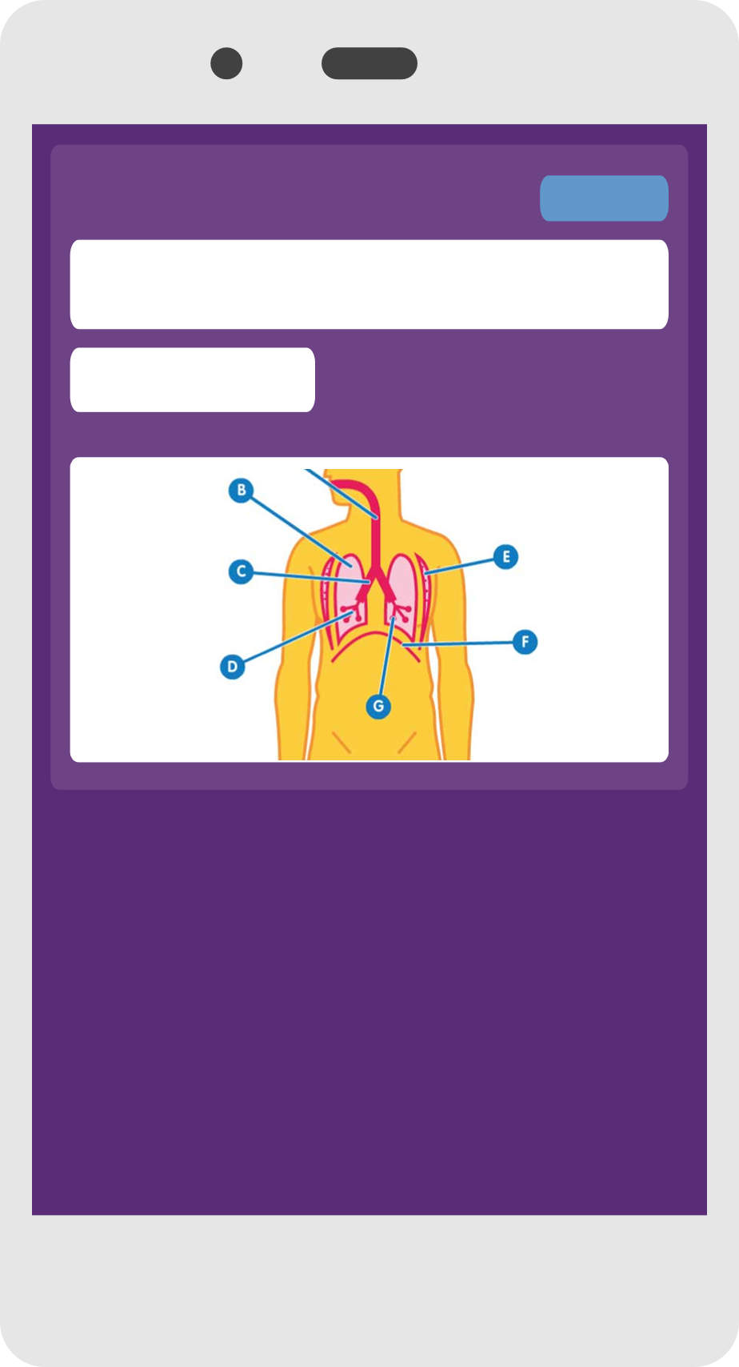
What is Educake?
Educake is a website for homework, classwork, and revision.
Teachers can set you homework.
You can set yourself revision quizzes.
You can use Educake on smartphones, tablets, and computers.

Slide 3
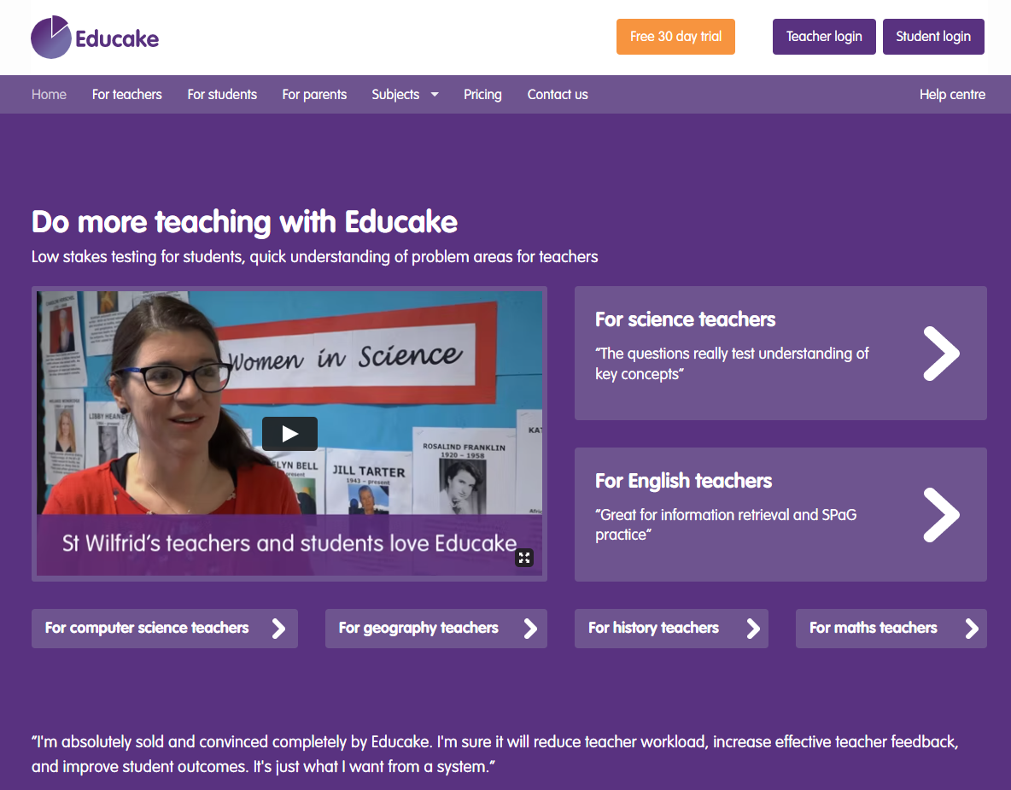
How do I log in to Educake?
Go to www.educake.co.uk.
Click on the “Student login” button.
Type the username and password your teacher gives you.
Your username is:
first name + first letter of your last name + a four digit number
For example, Brian Pie’s username is brianp0009.

Slide 4
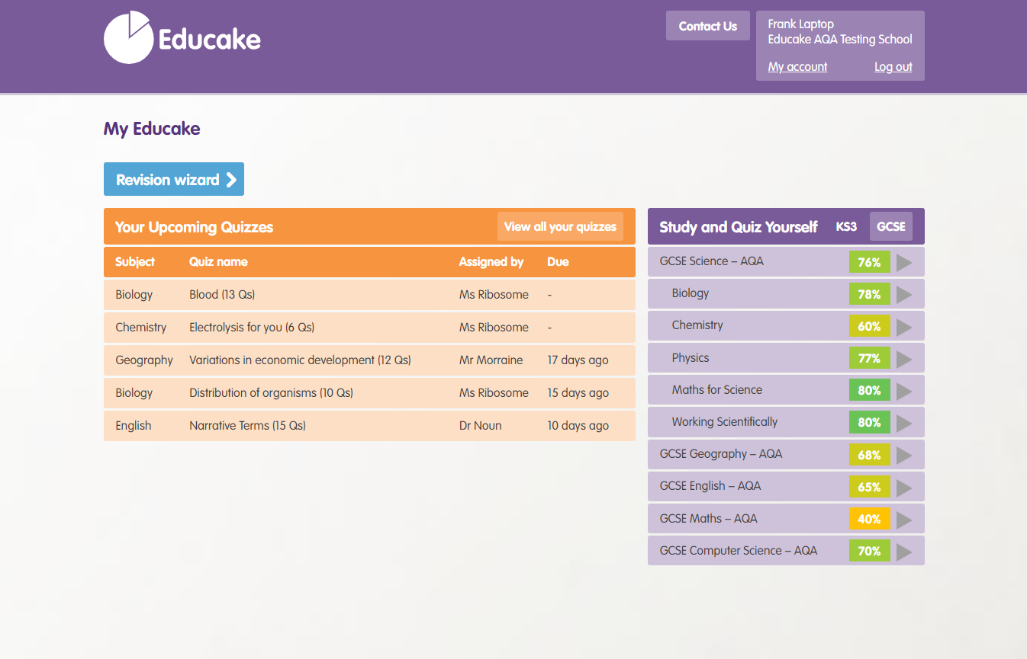
How do I do homework and classwork?
Quizzes that your teachers have set you are in orange.
Click on a quiz to answer
the questions.

Slide 5
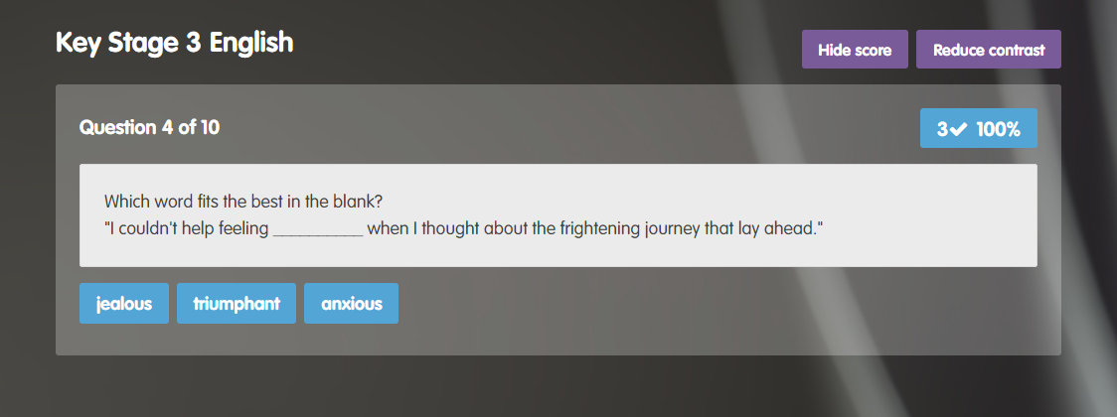
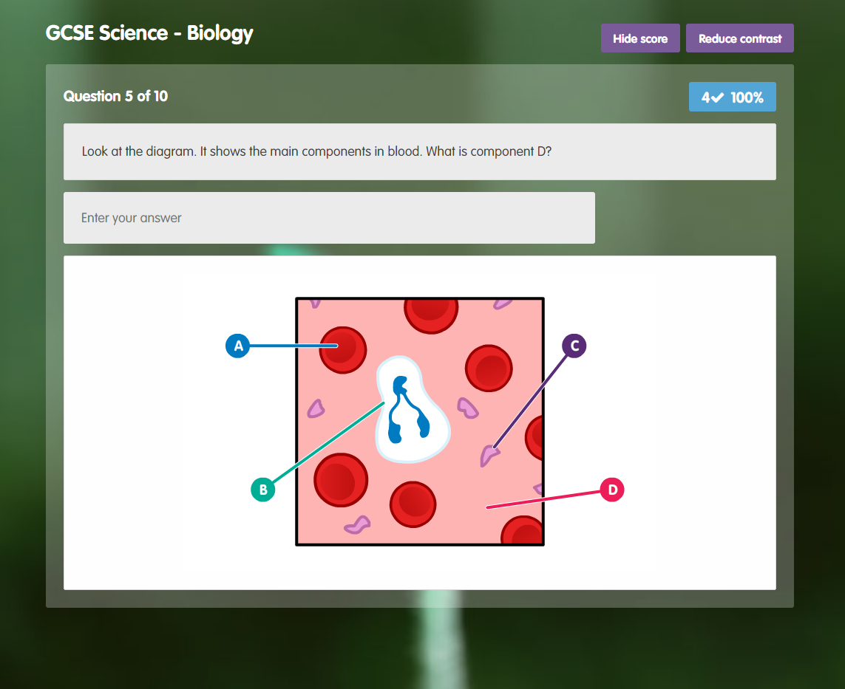
What are Educake quizzes like?
Educake quizzes are made of
short questions.
Some questions are multiple choice.
For other questions, you need to type in an answer.
You can make small spelling mistakes, but you should try to learn the correct spelling.

Slide 6
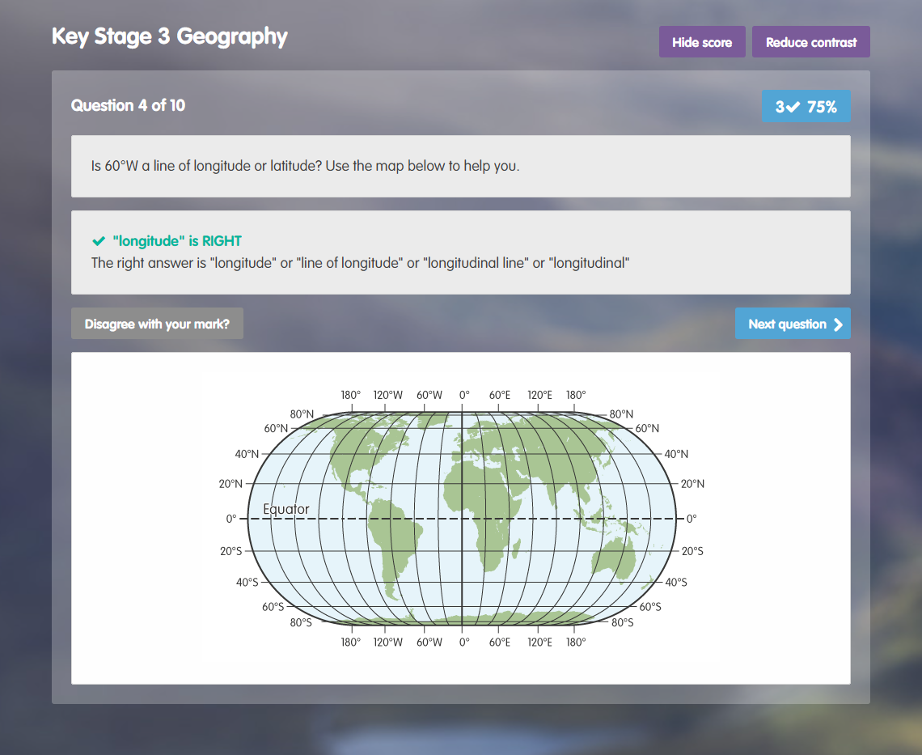
What are Educake quizzes like?
After you answer a question, you get feedback straight away.
You can ask your teacher about a question here:

Slide 7
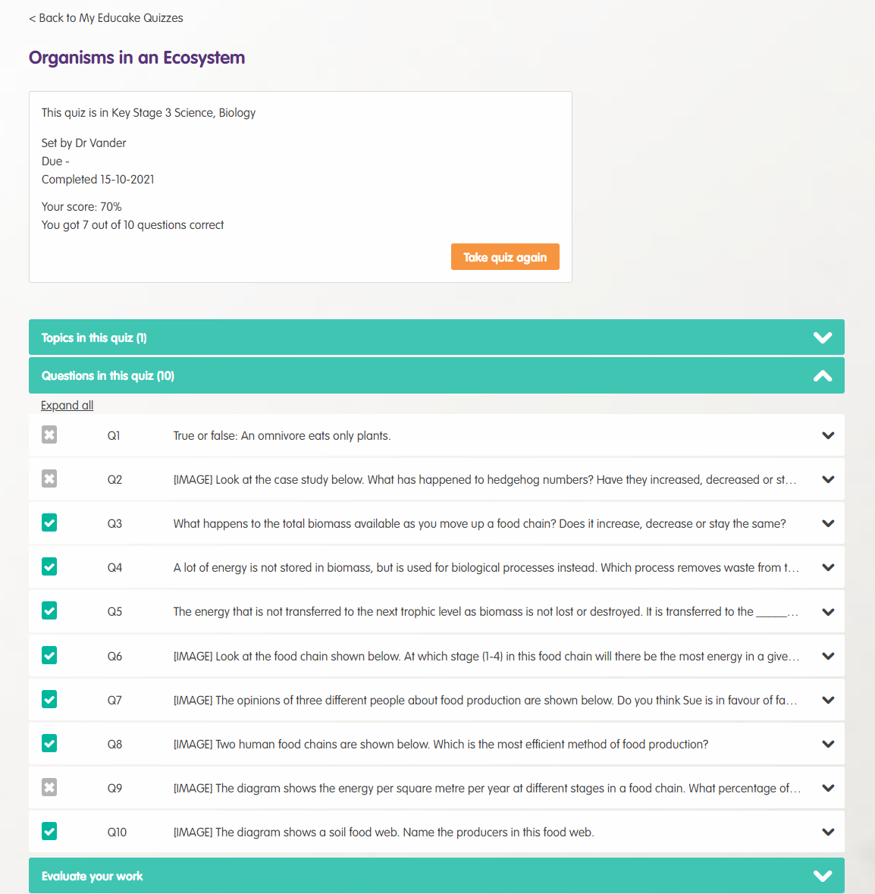
What are Educake quizzes like?
When you finish a quiz you can
see your results.
You can take the quiz again here:

Slide 8
How do I view my progress?
You can see your subjects here:
Subjects you know well are green.
Subjects you need to revise are red.
Click on a subject to see its topics.

Slide 9
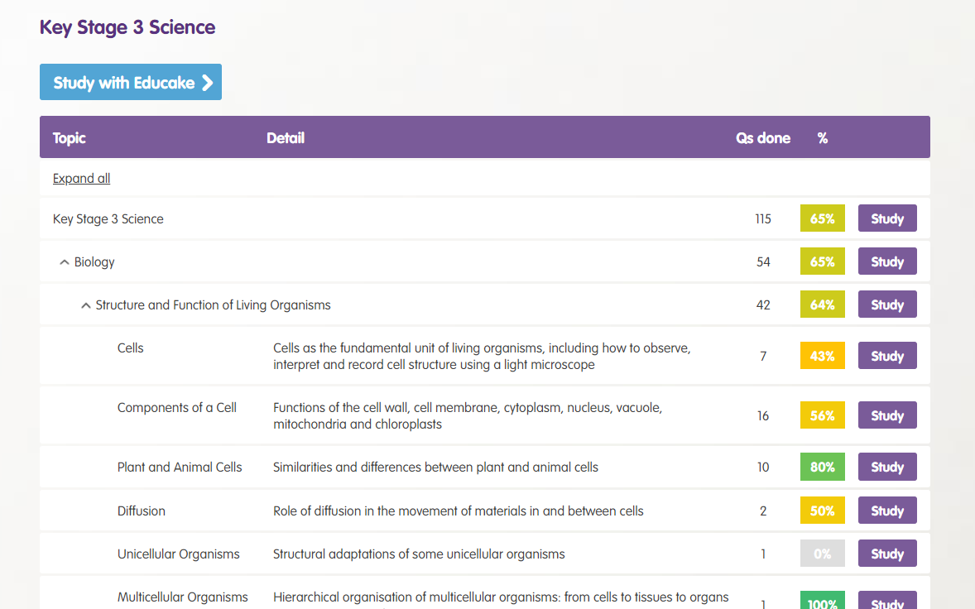
How do I revise?
When you click on a subject, you’ll see a list of all its topics.
Topics you know well are green.
Topics you need to revise more are red or orange.
Click “Study” next to the topic if you want to revise it:

Slide 10
How do I revise?
You can also let Educake choose a topic for you.
Click on the blue button here:
You can learn something new, revise a past topic, or let Educake pick.

Slide 11
To sum up Educake
To sum up Educake:
Your teachers can set you quizzes.
You can set yourself quizzes.
Educake shows you which areas you know and which areas you need to revise.
Keep practising! The more you answer questions, the better you will learn.

